Slide 1
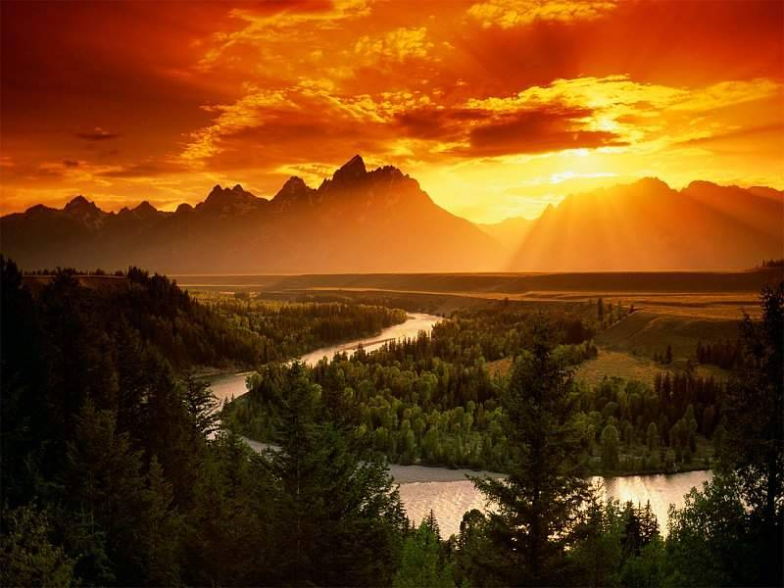
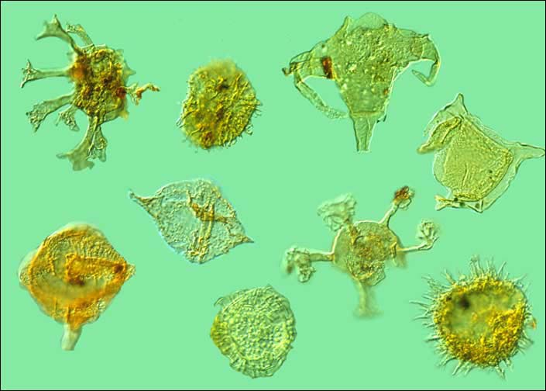
Lab 8: Energy
Sources of Energy
Fossil Fuel: The vast amount of energy we use today comes from sunshine that hit the Earth millions of years ago. Algae used sunshine to synthesize sugars and chains of sugars (starch & cellulose). After dying, bacteria stripped away oxygen, nitrogen, and phosphorus atoms. This left a gelatinous mass of carbon and hydrogen (hydrocarbons). After being buried under a mile or two of sediment, it formed petroleum (a fossil fuel). Ancient forests did the same thing; however, after they died and got buried, they turned into coal (another fossil fuel).
Algae

Slide 2
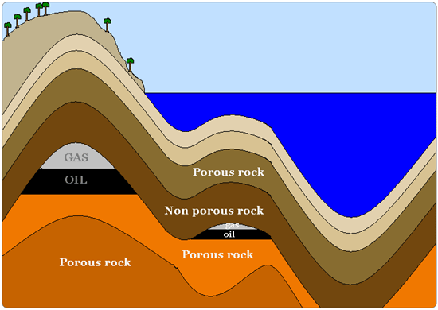
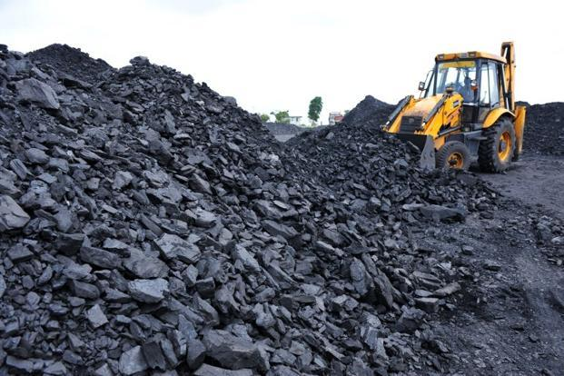
Lab 8: Energy
Sources of Energy
Fossil Fuel: After being buried under a mile or two of sediment, it formed petroleum (a fossil fuel). Ancient forests did the same thing; however, after the forests died and got buried, they turned into coal (another fossil fuel).
Coal

Slide 3
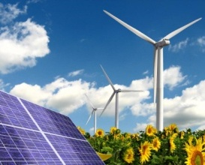
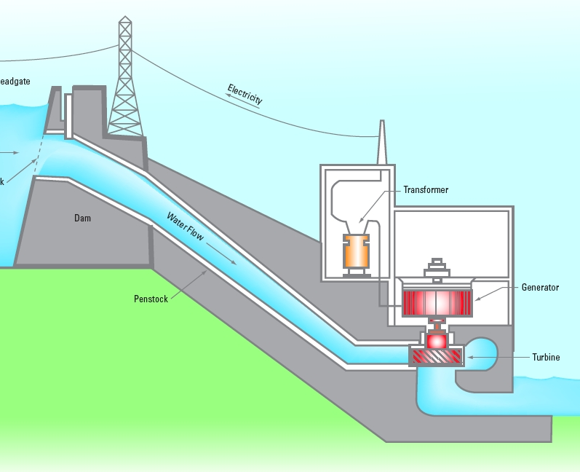
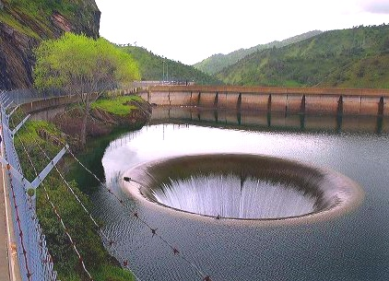
Daily Source of Energy: The energy in sunshine that we get daily is still used by plants to make sugar and chains of sugar (cellulose). The sugar gives us and all animals food energy. The cellulose (main component of wood) can be burned for cooking or staying warm. Sunshine can also provide power for solar panels. It also causes wind, which we can convert into electricity using wind generators. Sunshine also causes water to evaporate which often leads to rain. If that rain falls in mountains, the runoff can be trapped by dams. Water behind dams can turnn turbines to make electricity (hydroelectric power ). Using the daily output of the sun is renewable energy because it comes back every day. Using fossils fuels (natural gas, petroleum, and coal) will only come back in a few million years.

Slide 4
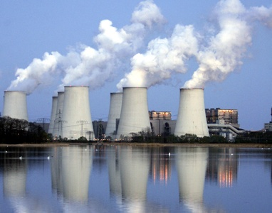
Energy not from Sun: The only two energy sources not coming from the sun are nuclear energy, which comes from radioactive elements in the soil, and from geothermal energy, which comes from the heat of the original formation of the Earth and from radioactive decay within the Earth.

Slide 5
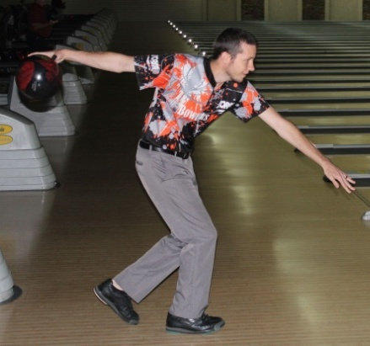
Forms of Energy
There are two basic types of energy: Potential Energy (stored energy) and Kinetic Energy (Energy from motion). The bowling ball here has potential energy because it is high above the ground. That energy is converted to kinetic energy as it swings to the floor. Other forms of Potential Energy are Chemical (gasoline), Nuclear (uranium), Gravitational (raised bowling ball/dammed water), and Mechanical energy (a compressed spring). Other forms of Kinetic Energy are Motion (object in motion), Thermal (atoms in motion), and Sound (vibration of atoms). Electromagnetic Energy (radio, infrared, visible, UV, X-rays), and Electrical energy (movement of electrons).

Slide 6
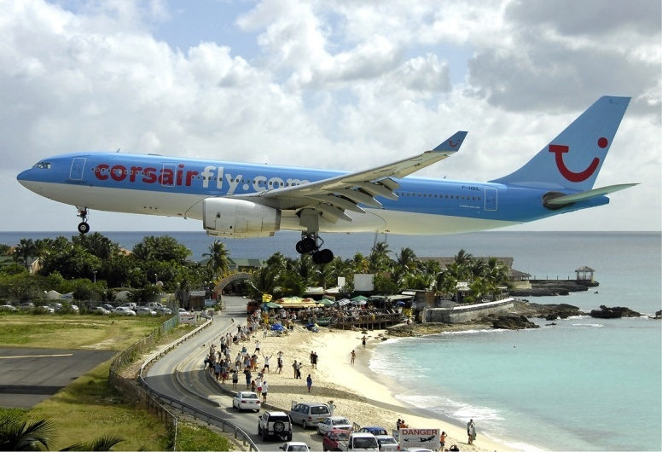
Conservation of Energy & Energy Conversion
Energy use: All societies use energy to carry out activities they believe are important. This includes transportation, lighting, construction, entertainment, and much more. Even though energy is said to be consumed, the truth is the energy was just converted to another form. For example, the plane started with thousands of
gallons of fuel (chemical energy) that gets consumed in flight. However, that energy is not gone but remains as mostly thermal energy in the air where the exhaust left the plane.

Slide 7
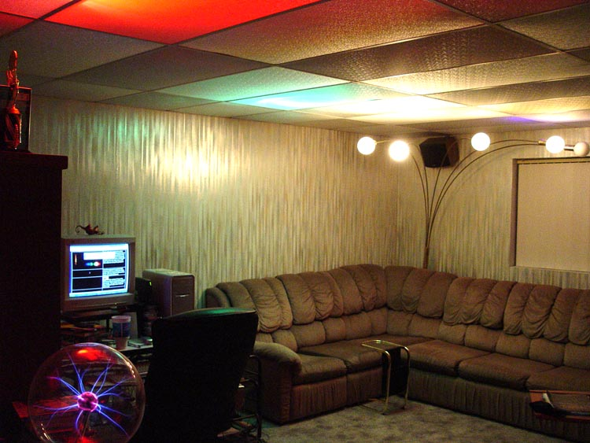
Another example, is when we use lights around the home. We think we are “burning up” electricity. But even when we turn off the lights, the energy used while the lights were on is still there. It’s still around as extra heat in the room.

Slide 8
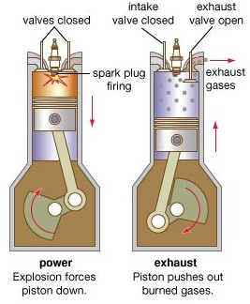
Conversion example : Sunshine (radiant energy) is absorbed by ancient algae to make sugar (chemical energy). Over time this transforms to petroleum, which contains gasoline (still chemical energy). In a car’s engine, combustion of gasoline & oxygen makes H₂O and CO₂. The breaking of gasoline bonds converts chemical energy to thermal energy which heats up the H₂O and CO₂ gases causing high pressure in the cylinder. High pressure pushes the piston down (mechanical energy) which spins the crankshaft (kinetic energy). About 80% of the
energy from combustion exits the tail pipe and radiator and is wasted as heat. Energy of the spinning crankshaft transfers to the wheels causing the car to move (kinetic energy). A moving car pushes against the air causing the air to move faster. That ends up heating the air (thermal energy). Unless a car is driving up hill, about 99% of the original chemical energy from gasoline becomes thermal energy. Thermal energy is usually the last form of energy that results from using other forms of energy.

Slide 9
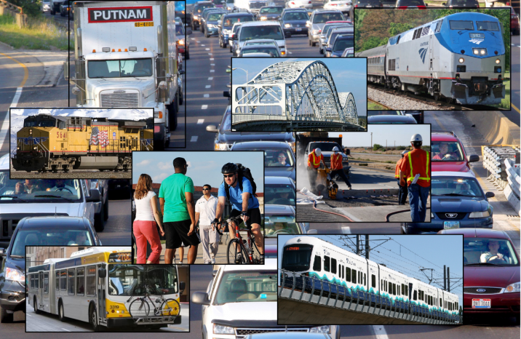
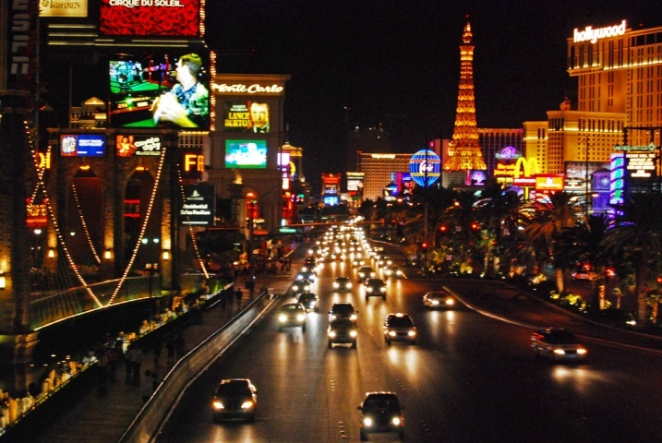
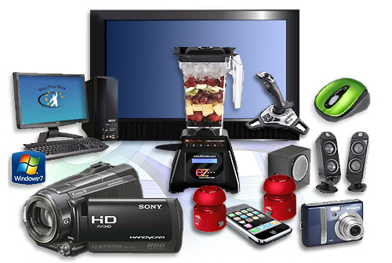
Waste Heat: Energy is used for many things such as transportation, lights, and the running of our appliances and entertainment devices. Unfortunately, much of this energy gets converted to heat that wasn’t wanted. So that is waste heat. For example, a camcorder uses battery power to record video and to display it on the screen; however, electrical resistance in the electronics causes the camcorder to heat up. So some of the battery power (chemical energy) gets wasted in heating up the camcorder. Unless you had cold hands, this extra heat is a waste of energy.

Slide 10
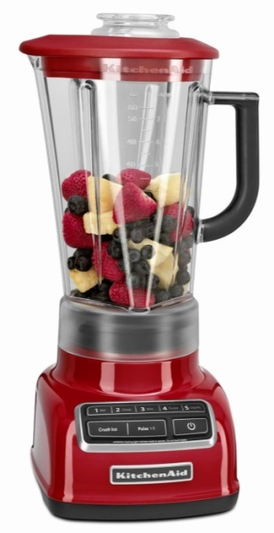
Blender’s Waste Heat: A blender is a good example of energy getting converted to unwanted heat. We want electricity to simply blend the food and that’s all. Unfortunately, the powerful motors in blenders need a lot of electrical current to flow though coils of wires to make a strong electromagnet that pull and push on other magnets to spin the motor. Electrons passing through the wires bump into stationary copper atoms (electrical resistance). That causes the copper atoms to vibrate which results in heat. To keep the blender from overheating, a fan is used to blow away this heat. The spinning blades that blend the food also encounters friction with the food and that warms up the food. About 95% of the electrical energy that goes into the blender is turned into heat (Waste Heat). Only about 5% is used to blend the food. If the copper wire was replaced with superconducting wire there would be no heating of the wire and the blenders could use a much smaller electric motor.

Slide 11
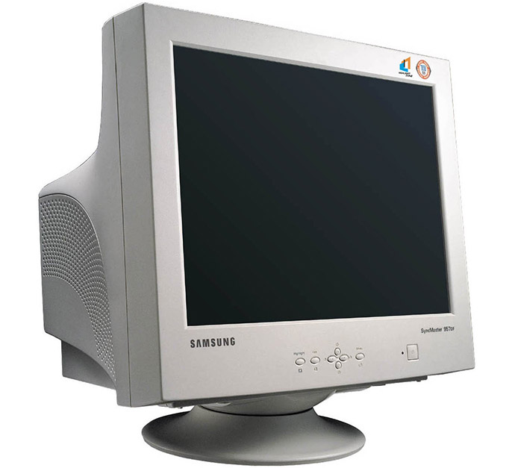
28 watts
160 watts
Solution to Waste Heat: The best way to avoid spending money and energy resources on items that turn much of it into waste heat is to use items that are much more efficient. That’s because in places like Arizona where it’s usually hot, inefficiency costs double. First there’s the cost to operate the item and then there’s the cost to cool down the home, house, or business due to the waste heat the item released.

Slide 13
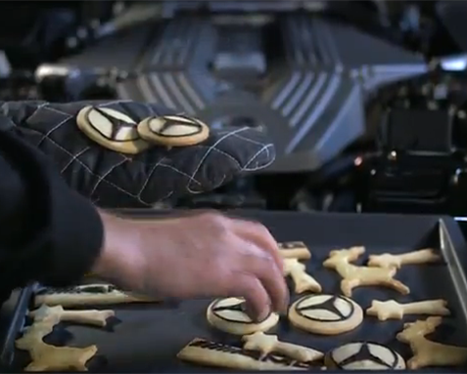
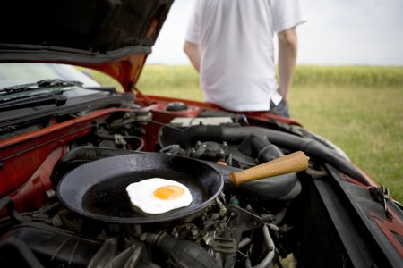

Slide 14
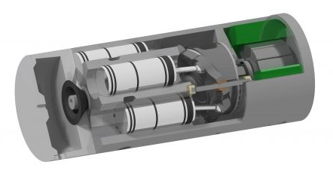
Some car companies have tried to capture the heat in the exhaust and use it to generate electricity. For example, in the diagram, exhaust heat evaporates a liquid that pushes on the pistons that turn a crankshaft (like a miniature engine).

Slide 15
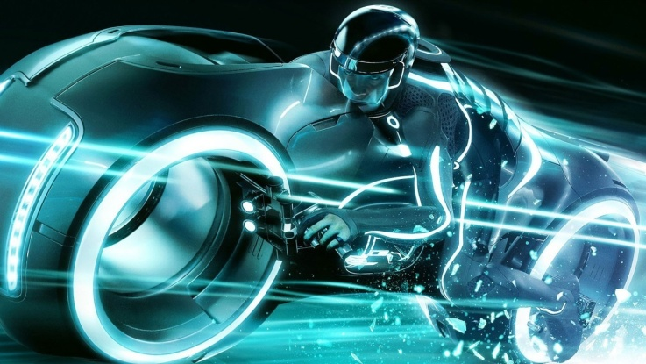
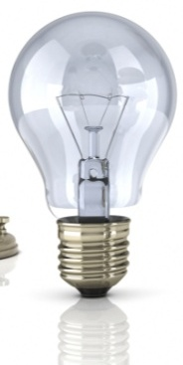
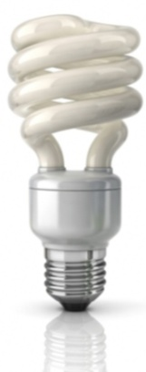
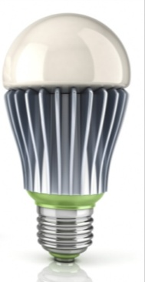
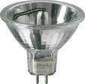
Energy efficiency of lighting
Incandescent Halogen Fluorescent LED Electroluminescence

Slide 16
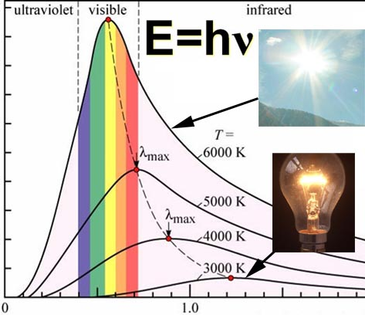
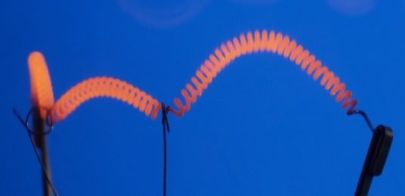
Incandescent bulbs: Halogen and standard incandescent bulbs both depend on heating up a tungsten filament until it glows. Halogen bulbs contain a halogen such as iodine or bromine which lengthens the life of the tungsten filament. The temperature of the filament for a standard
Wavelength () in m
incandescent bulb is about 2700 Kelvin. That means about 95% of the light it creates is in the infrared region that we cannot see. A halogen bulb filament is about 3000 Kelvin so its output shifts closer to visible light making it a little more efficient.

Slide 17
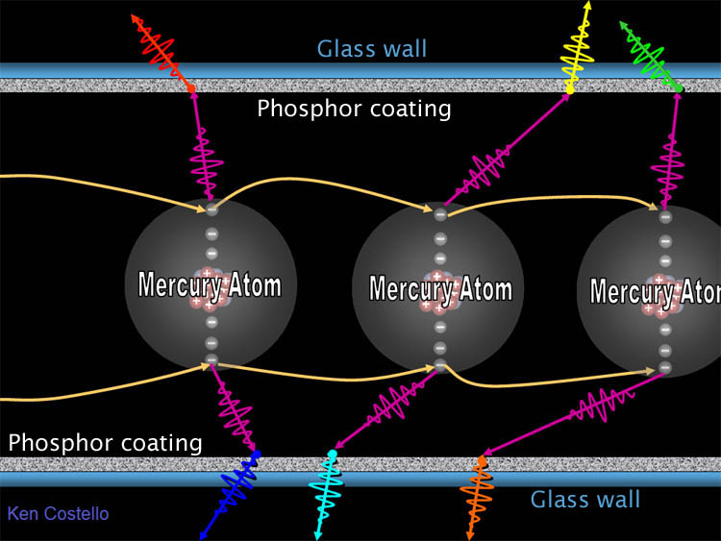
Fluorescent bulbs: Fluorescent lamps have a different strategy for making light. They use high voltage to cause electrons to jump from mercury atom to mercury atom. As electrons fall into orbit around a mercury atom, they give off a photon (packet) of ultraviolet light. When a UV photon strikes phosphors that coat the inner wall
of the fluorescent tube, the phosphors absorb the UV light and emit visible light of specific wavelengths. The below spectrum shows that one particular fluorescent lamp had phosphors that emitted blue, turquoise, green, yellow, and red light. The corresponding wavelengths for these colors are 440nm, 495nm, 540nm, 590nm, & 620nm. Our eyes perceive them together as white light.

Slide 18
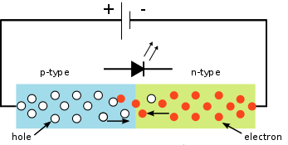
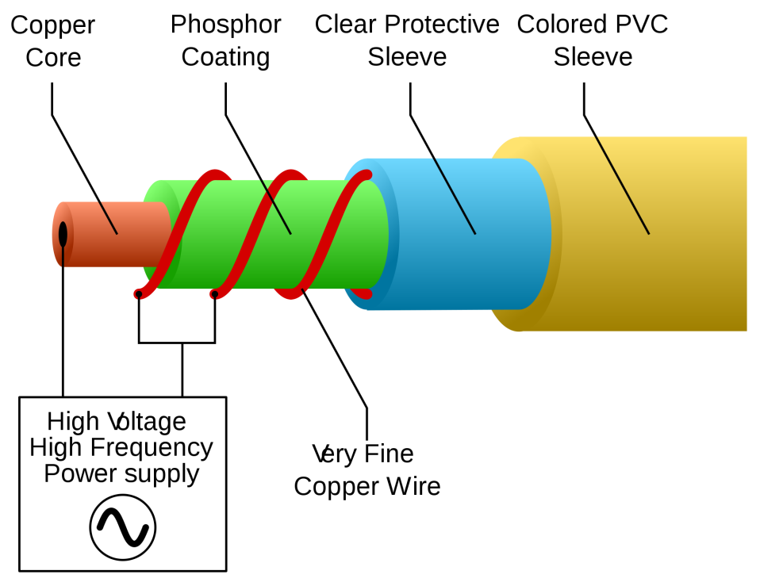
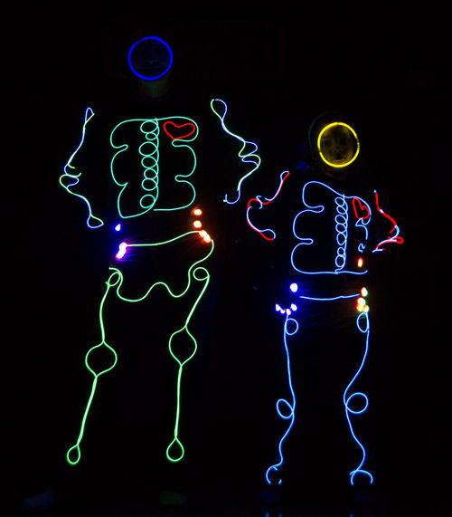
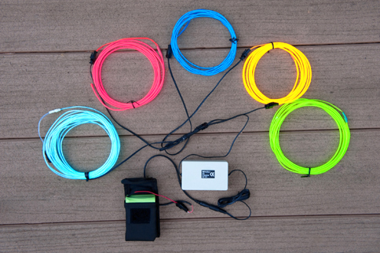
LEDs 3 volts direct current. Low amps
Electroluminescence 100 volts Alternating current 1000 Hz. Low amps

Slide 19
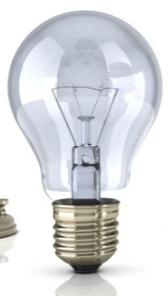
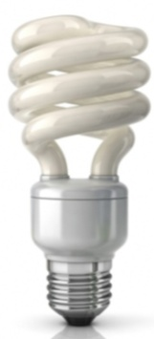
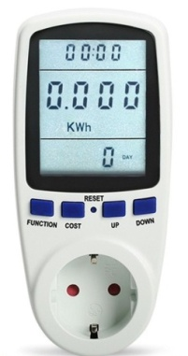
Lab 8: Energy: Measure light bulb efficiency
Watt meters
Incandescent Halogen Fluorescent LED
1) Measuring wattage : Hook up these 4 types of bulbs to a watt meter and record their watts consumption.
Incandescent: ______ watts
Halogen: ______ watts
Fluorescent: ______ watts
LED: ______ watts

Slide 20
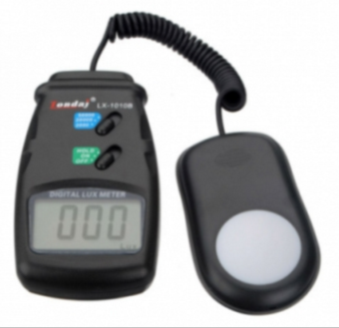
Light Meter: These kind of light meters are measuring how much visible light is hitting a surface. They do not register infrared or ultraviolet light. They are used by photographers to set camera exposure and by architects who want to design the right amount of light to light up work areas. These meters measure in a unit called a Lux. Light bulbs are often labeled with their brightness in lumens which represent the total amount of visible light coming from the bulb. Lux measures the amount of light that is spread out over a certain area away from the bulb.
2) Measure brightness using light meter: Use a light meter to measure the lux at 12 inches away from each of the below bulbs. (Note: most smartphones also have built-in light meter). For one setup, a smartphone will be used to measure Lux values.
Incandescent: _____ Lux
Halogen: ____ Lux
Fluorescent: ______ Lux
LED: ______ Lux
Try to block the room lights from hitting the light meter.

Slide 21
Comparing bulb efficiency: Since these bulbs are have different wattages, it’s not fair to judge their efficiency by the lux value ; however, by dividing the lux value by the watt value, we get lux per 1 watt. That allows you to compare them fairly because you are discovering how many lux each watt of that bulb produces.
3) Calculate the lux per watt for each bulb: Whenever you see “per” that’s a clue to divide the measurement in front of “per” by the measurement after the “per”. In other words, the “per” is replaced with a divide sign ( ÷ or / ). So to get lux per watt, divide the lux values by the watt values for each bulb.
Incandescent:______ lux/watt Halogen:______ lux/watt Fluorescent:______ lux/watt LED:______ lux/watt

Slide 22
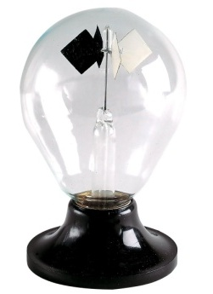
Energy wasted: In all 4 bulbs, not all of the energy being consumed (watts) is going into producing visible light. Some energy goes into producing ultraviolet light and infrared light (mostly infrared light) that we can’t see. The radiometer on the left reacts mostly to infrared light. The black surfaces absorb more of the visible and infrared light than the white surfaces. That makes the black squares hotter. This heat transfers to the argon gas around the black squares. The fast moving argon atoms strike the surface of the black square harder therefore pushing it in that direction. Shine the four lights on the radiometer and see if you can tell which one makes the radiometer spin the fastest, which is likely the one that makes the most infrared.
4) Bulb that made the Radiometer spin the fastest: ________________

Slide 23
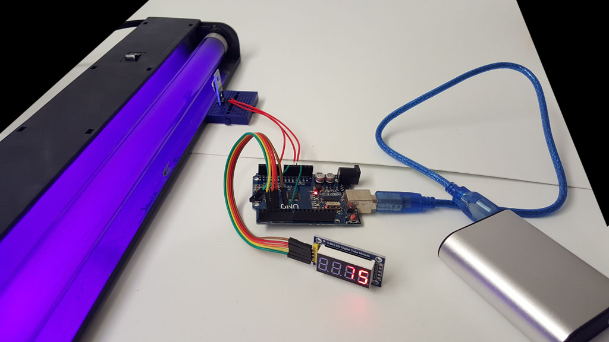
UV light: A bulb that produces infrared light is wasteful, but a bulb that produces UV light can be harmful to skin and eyes. Using the Arduino based UV meter, report which one is producing the most UV light.
5) _________________

Slide 24
Bulb ID with Spectroscope: A fluorescent bulb is easy to identify by its spectrum. They have bands of color in the spectrum due to the phosphors emitting certain wavelengths of light. What wavelengths are emitted by the fluorescent bulb? (The numbers are in 100’s of nanometers)
6) ________________________________
________________________________

Slide 25
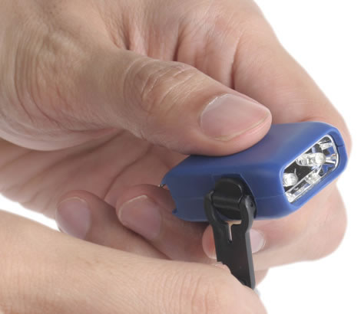
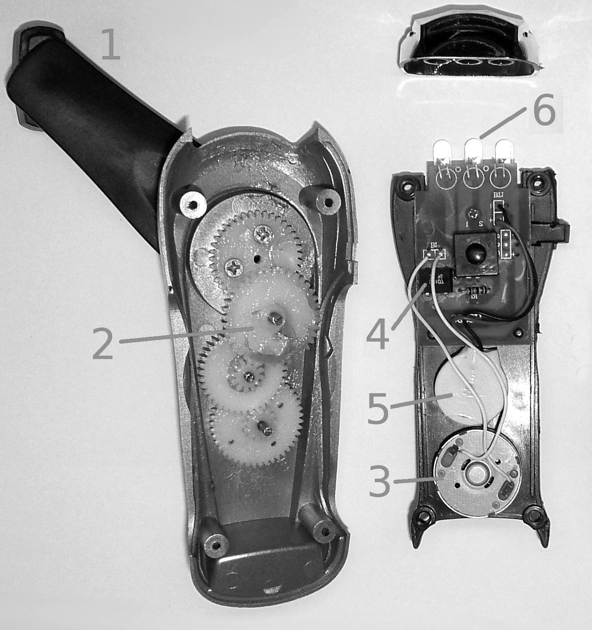
Lab 8: Energy: Energy conversion
Hand-cranked powered flashlight: Even though these small hand-cranked flashlights seem simple, the energy from cranking goes through many forms.
Hand crank
Multiplier gears
A/C generator
A/C to DC rectifier
Lithium battery
LED lights

Slide 26
Conservation of Energy vs. Conserving Energy: Note these two titles are not the same.
Conservation of energy is a law in physics that says energy cannot be created or destroyed; it can only change form. In other words, it’s always conserved is some form.
Conserving Energy means not being wasteful with energy by using products that are more efficient or having habits that consume less.

Slide 27
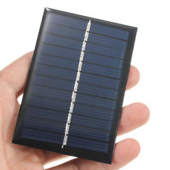
Factors that affect solar panel efficiency : Photovoltaic cells (solar panels) are a fast growing source of electrical energy. Connect the solar panel to multimeter and use the Sun to illuminate the solar panel. Determine the effects of the following conditions on the output of the solar panel. Indicate the solar panel #.
2) Angle of Incidence: What happens if the solar panel is not perpendicular to the incoming light?
3) Effect of a shadow: Some types of solar panels are more negatively affected by shadows (like from a tree). Try shading about ¼ of the panel and see how the energy output is affected.
4) Effect of temperature: Solar panels are less efficient at higher temperatures. Try using ice to lower the temperature of the solar panel. What effect did you see.

Slide 28
Lab 8: Energy: Waste Energy (Waste Heat)
Electric Cooling Fan: Being here in Arizona, we are very appreciative of cooling fans. From our experience we think fans are cooling the air, but they are actually heating the air. They feel like they are cooling us because the air blowing over our sweaty skin will accelerate the evaporation of the sweat. When water (sweat) evaporates, it needs to absorb energy. When it does, it cools the area around it. Even if the skin is not sweaty, there is a layer of warm air sitting right next to the skin. The fan blows that warm air away replacing it with cooler room temperature air.

Slide 29
Lab 8: Energy: Waste Energy (Waste Heat)
5) What’s hot or warmer than room temperature?: Waste heat can be found by looking for devices that are warmer than room temperature. Use the infrared thermometer to check devices around the lab to see if they are warmer than room temperature. Transformers and light bulbs are two usual waste heat creators. List what you found that was producing waste heat.

